Slide 1

ELECTRIC VEHICLE SIMULATION
INTER IIT TECH MEET 9.0

Slide 2
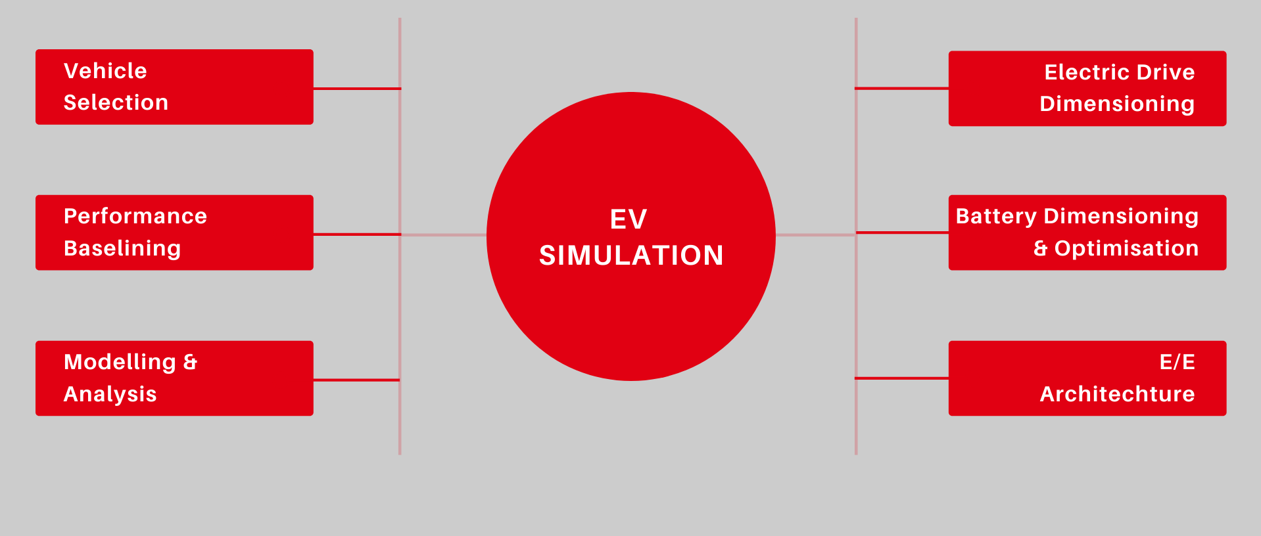
OUTLINE

Slide 3
Vehicle Selection

Slide 4
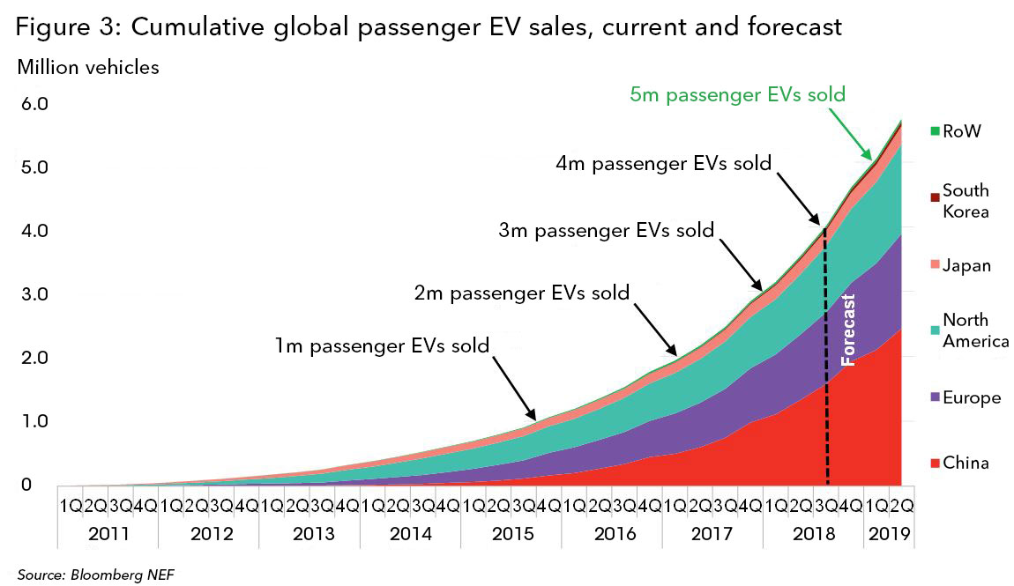
Choice of Segment – Passenger Car
India harbours around 30 million cars today
The International Energy Agency (IEA) finding suggests that the passenger car ownership in India will grow by 775% over the next two decades
Very relevant means of transport, affects a huge part of society
Most major contributor of emissions among automobiles
Exponentially growing demand for EV PC
Global Passenger EV sales

Slide 5
Performance Baselining

Slide 6
Design Requirement
Design Parameter | Performance | Rationale
Maximum Speed | 210 kmph | Most PC's in the Indian Market have 200-220 kmph max speeds.
0-100 kmph Acceleration | Within 5.2 Seconds | Typical for EV’s in the global market.
Overtaking Capability(Overtaking 10 m at 80-100 kmph) | 5 seconds (1:Lateral + 3:Longitudinal + 1:Lateral) | Can withstand accelerations upto 2.22m/s^2 (or around 0.25g acceleration) at around 80-100 kmph speed for overtaking(extreme)
Gradability | 30% (slope = 0.3) at 70kmph | Most roads in India are flat, even where there are slopes the gradient rarely exceeds 25%

Slide 7
Vehicle Assumptions
Weight : 2000 kg (Heavier than combustion Sedan cars due to Battery pack)
Drag Coefficient : 0.28 (Between 0.25 and 0.3 for a PC)
Frontal Area : 2.5 m (Comparable to a normal PC)
Gear Ratio : 9 (Fixed total GR found in most Cars)
Radius : 30 cm
Rated Rpm of Motor: 3600 rpm
Max Rpm of Motor: 8000 rpm
Rated Speed = 60*f/p
f: Input Frequency, p: Number of Pole Pairs

Slide 8
Performance Baselining
Performance | Max Torque* (0 to rated rpm) | Max Power*(rated rpm to max rpm) | Approach
Maximum Speed 220 kmph (+10% FOS) | 368.63 Nm (derived from power) | 138.97 kW (97% efficiency assumed) | The max power required is calculated from power required to counter air drag at that speed
0-100 kmph Acceleration in 5.2 Seconds | 366.59 Nm | 138.20 kW (derived from max torque) | Max torque is calculated from from a simple DE: conserving force for 5.2 seconds at full throttle, vf=27.78m/s
Overtaking Capability(in 5s) | 362.05 Nm (derived from max power) | 136.49 kW (97% efficiency assumed) | Longitudinally: covering 10m in 3 sec relative to other car at same initial speed at full throttle
Gradability 30% (slope = 0.3) at 70 kmph | 309.40 Nm (derived from max power) | 116.64 kW (97% efficiency assumed) | Countering effects of gravitation and wind resistance(minor) at given velocity
Notes:
Max torque and max power for the motor are linked through a formula: Torque*angular velocity=Power. Max torque required and max power required for each scenario can be calculated. The greater value out of max torque and max power from the relation is stated in the table.

Slide 9
Modelling & Analysis

Slide 10
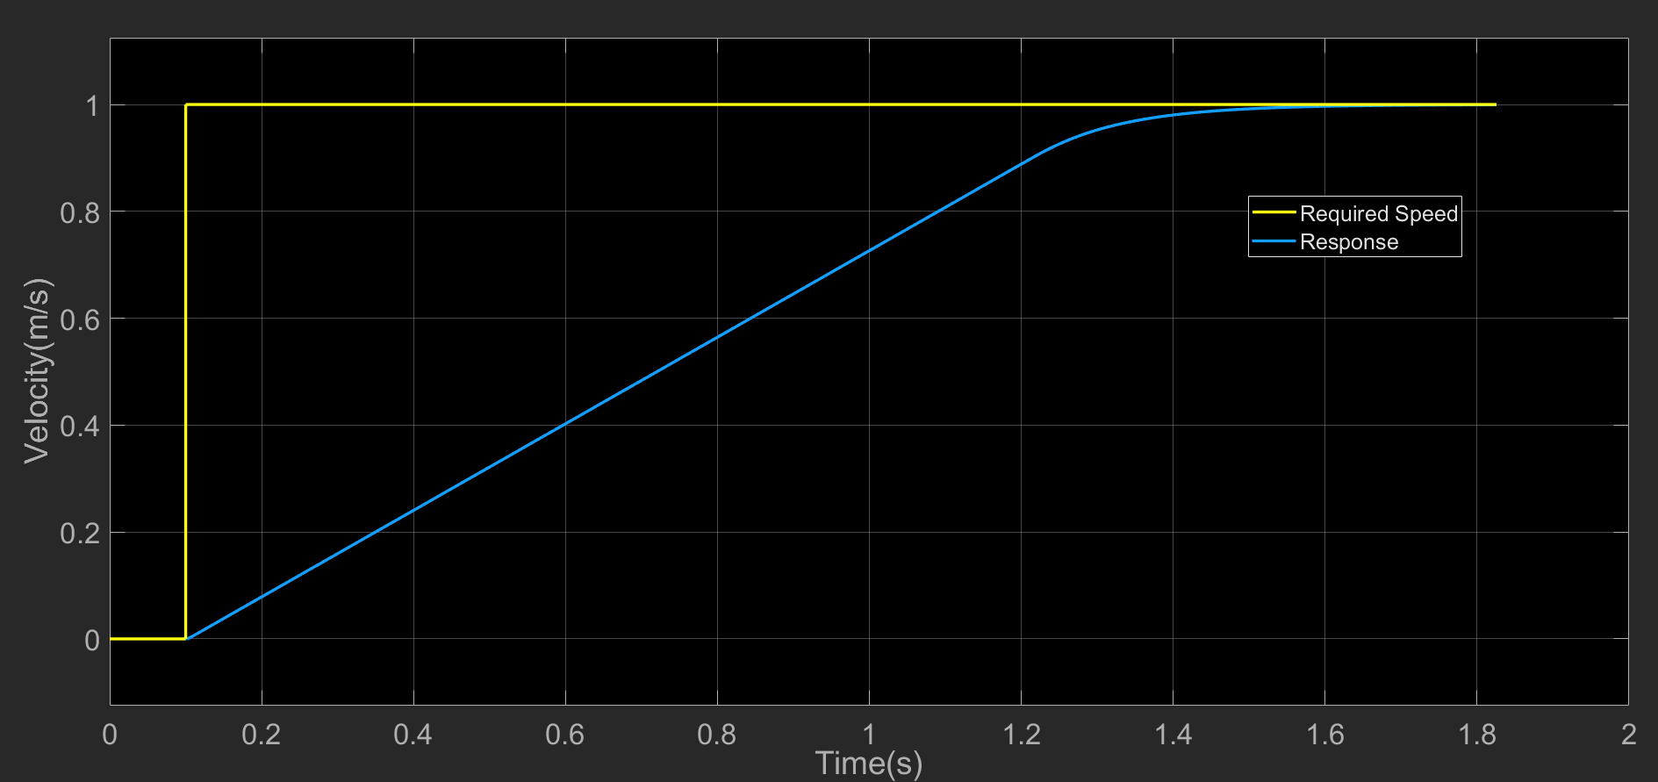
Performance Baselining
From the Performance Baselining:
Maximum Torque: 368.63 Nm
Maximum Power: 138.97 kW
Notes:
Out of the values for max torque and max power, the highest requirements are set as our final requirements.

Slide 11
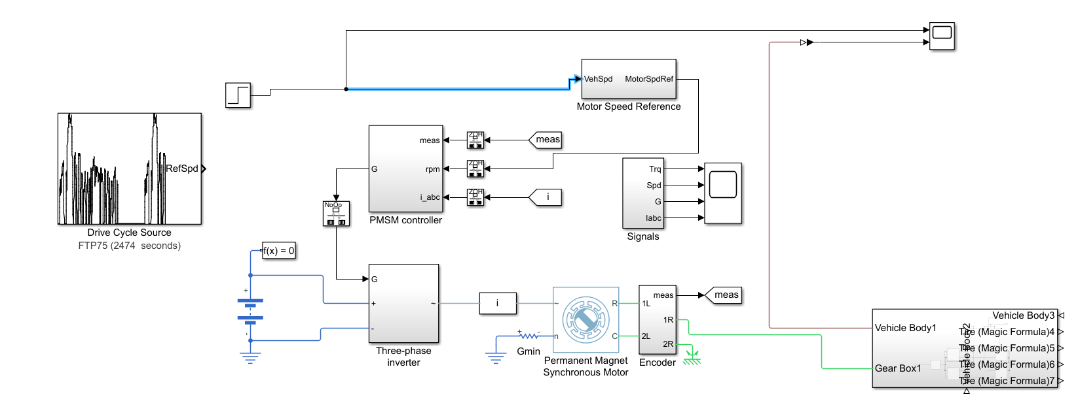
Simulink Model

Slide 12
Electric Drive Dimensioning

Slide 13
PMSM Motor Design
Base Speed
Max Torque
Max Power
Target Efficiency
Ld
Lq
Flux Linkage
Resistance
Target parameters(max Torque, max RPM, nominal RPM and max Power) are taken from the performance baselining.
Electrical Parameters (Flux linkage, Ld, Lq and internal resistance) are derived.
Electrical parameters are used to get the physical parameters of motor (air gap)
Notes:
Flux: Speed range is related to the magnitude of magnet flux linkage, since small magnet flux in the air gap means there is some larger flux-weakening capability. However, extending speed range is achieved at the cost of lower torque in the constant torque region.
Lq: Higher q-axis inductance only increases the torque below the base speed, but has no effect on the extending of flux-weakening speed range
Ld: It has the similar effect as the flux linkage on the constant torque region, but higher d-axis inductance value extends the flux weakening speed range significantly.

Slide 14
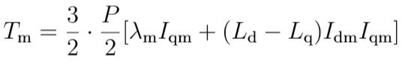
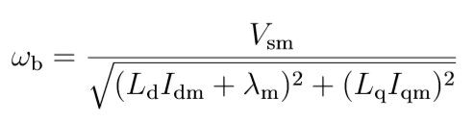
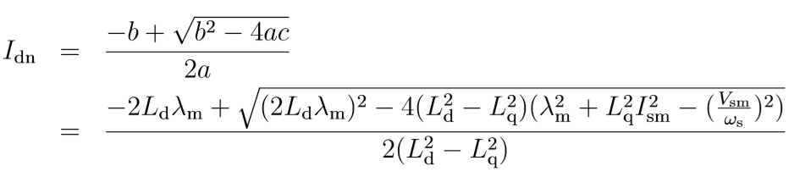
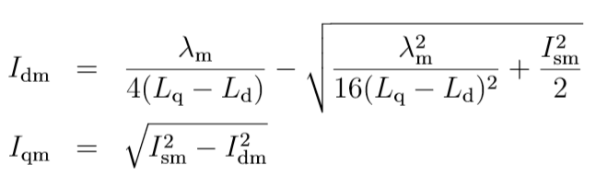
Motor Modelling Equations
Calculating Torque
Calculating Motor Speed
Calculating Phase Currents
For Constant Power region
For Constant Torque region
Notes:
Explain how the equations are solved to get Inductances and flux.

Slide 15
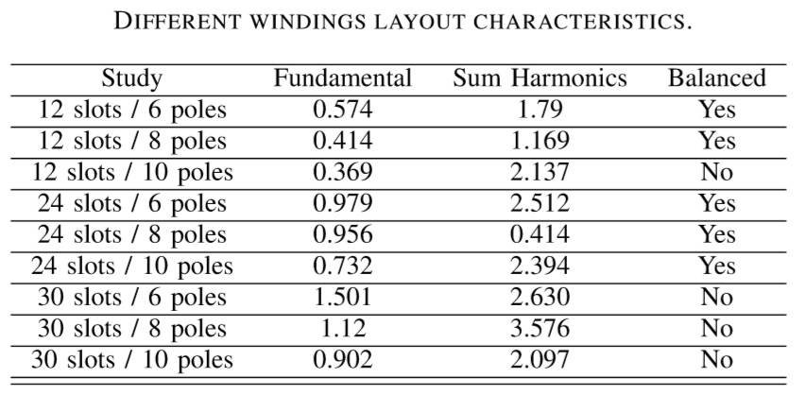
PMSM Motor Design
Motors with saliency
Considerable loss of magnetic flux.
Better protected from mechanical and magnetic stress.
Non -Salient PMSM
Higher flux linkage
Higher mechanical and magnetic stress.
We preferred to go with Saliency Motor
Notes:
A study Showed that the ratio of 30 slots to 6 poles gives 1.5 as fundamental mmf amplitude per amp.

Slide 16
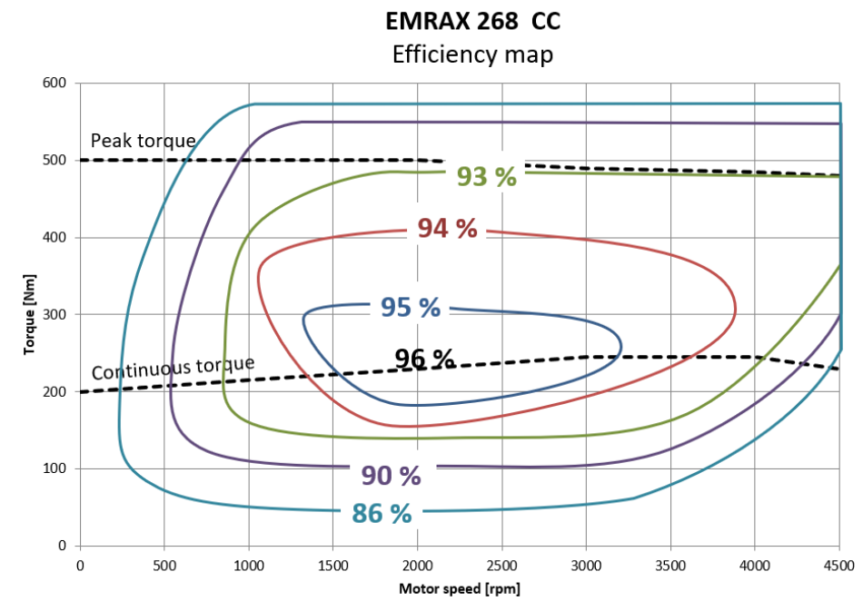
PMSM Motor Design
Notes:
Explain about efficiency curve

Slide 17
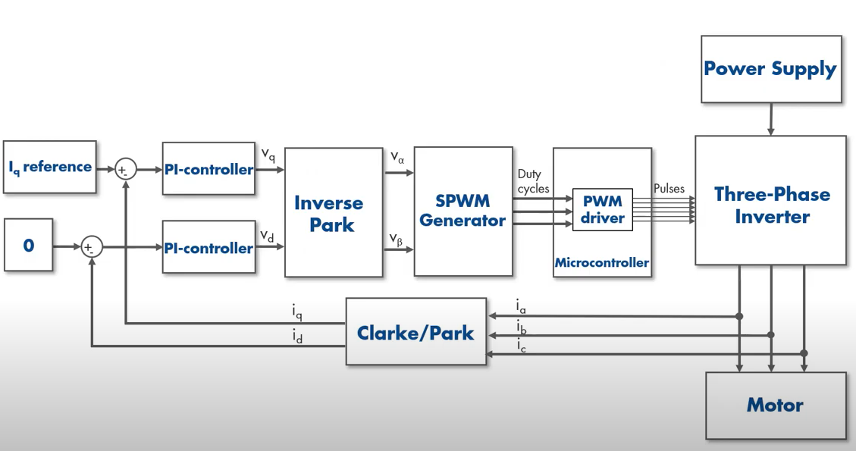
Motor Controller Design
Field Oriented Control
Notes:
Explain field oriented control. Mention Flux weakening region and SV PWM

Slide 18
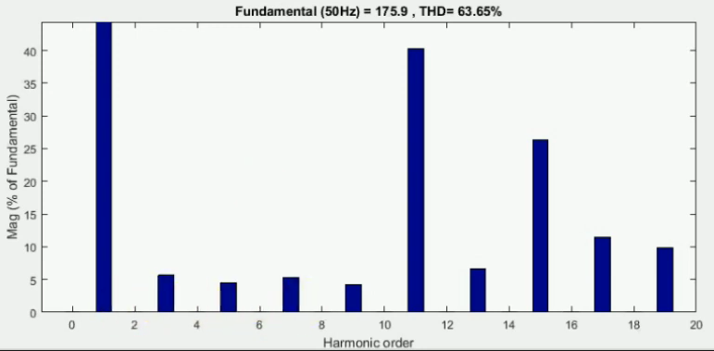
Motor Controller Design
Selective Harmonic Elimination Technique is integrated with the SV PWM technique to reduce the lower order harmonics.
Construct output voltage waveform by controlling the angle of edges in such a way that selected harmonics are cancelled out.
Higher Order Harmonics can be removed using low pass filters
Switching frequency is determined by limitations of MOSFET/IGBT in the high speed region
In low speed regions, it is determined by the system performance requirement.
Harmonic Elimination

Slide 19
Battery Dimensioning
& Optimisation

Slide 20
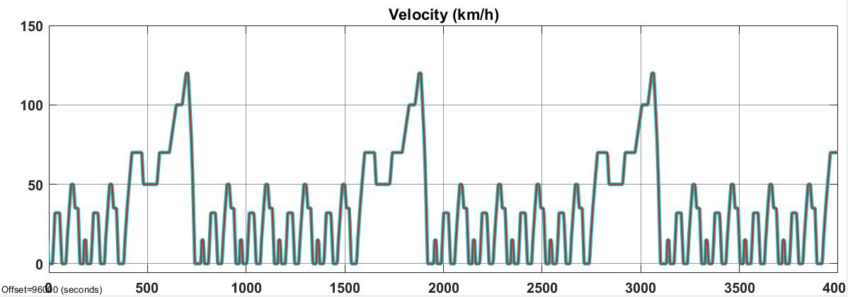


Battery Dimensioning
Single RC circuit based Battery Model
NEDC Drive Cycle
Model Parameters
Driving Power demand
Target Range
Drive Cycle
Motor Curve
Output
EV Battery Size
Velocity (km/hr)
Time (s)
EV Target Range
Pack Voltage
Energy content required
200 Kms
700 V
35 kWh
Drive Cycle
Pack Capacity
Pack Configuration
NEDC
50 Ah
195s17p ( 18650 Li ion cells )

Slide 21
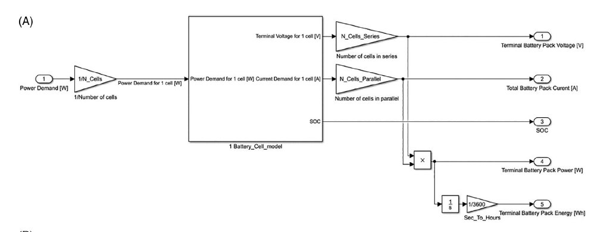
Battery Model
N_cells = 576
Obtained from the NEDC Drive cycle requirement and the Emrax 268 motor characteristics

Slide 22
E/E Architechture

Slide 23
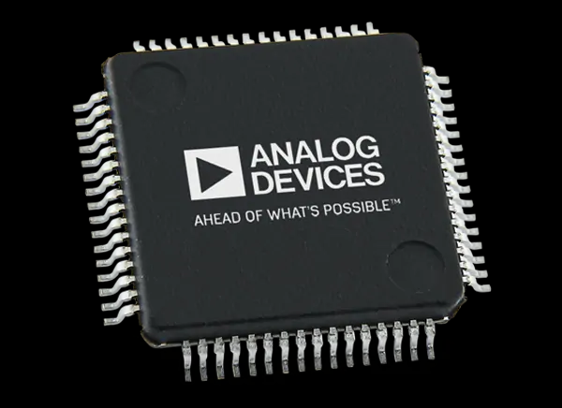
BATTERY MANAGEMENT SYSTEM
BMS centred around the LTC 6813 battery monitor IC by Analog Devices
18 series cells per IC
Multiple ICs are stacked to monitor multiple cells
Highly noise immune isoSPI protocol for communication
Low voltage measurement error of 2.2mV
Supports Active Cell Balancing for improved range
SoC estimation using Coulomb counting method
Cells
Cell balancing
Slave boards
Master board
Data transfer
Cell parameters
Charger
Notes:
Our BMS is centred around the LTC 6813 battery monitor ic from analog devices. This IC allows us to take up modular master slave approach and is also robust with a highly noise immune isoSPI protocol. Each IC can monitor 18 cells and also supports active cell balancing which improves the vehicle range. Coulomb counting method is used for State of Charge estimation. In this method, we make use of the current sensor signal and our battery pack’s voltage to estimate the energy consumed from our battery pack. The battery management system also measures the cell temperatures and makes sure they are within safe limits, in case cells get overheated BMS kills the car. It also monitors the charging process and stops charging in case of short circuit.

Slide 24
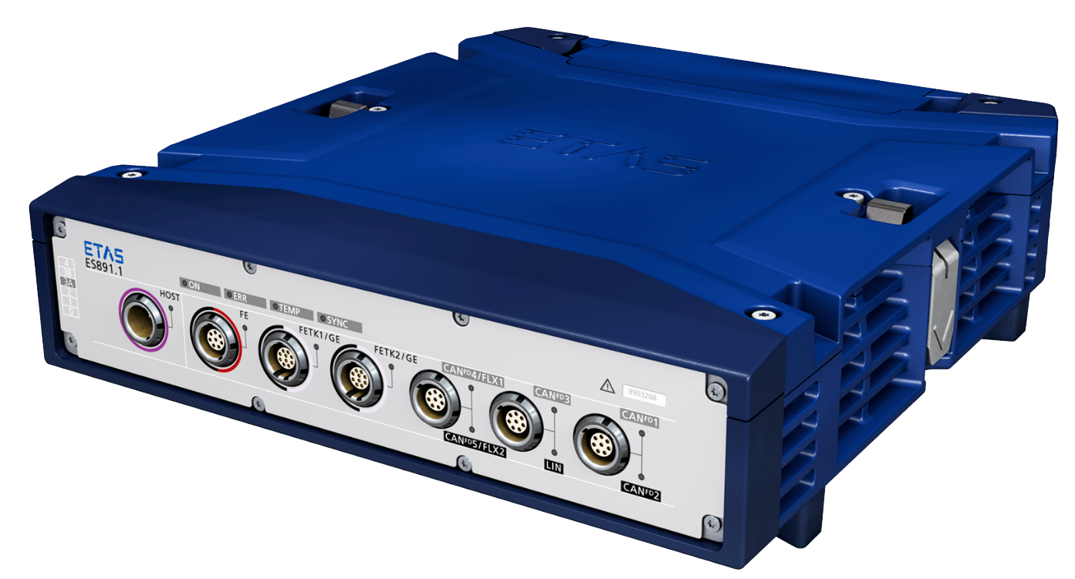
CONTROL UNIT
ETAS 891 ECU is a robust and capable solution with the following features
Timing accuracy better than 1 µs
Time synchronization compliant with IEEE1588 Precision Time Protocol
Robust metal housing (IP44)
One FlexRay interface with two channels
Up to five CAN / CAN FD interfaces
One LIN interface
Wake-up on CAN, CAN FD, and FlexRay
Flexray Interface
Used for safety critical signal communication like Brake Plausibility device, Airbag actuation signal etc..
Faster and more reliable than CAN
CAN Interfaces
Used for non-safety critical signal communication like windshield viper, window screen commands etc..
Notes:
This is the commercially available ECU that we have chosen based on our requirements. The ETAS 891 ECU is a robust capable solution for the control unit of a Electric vehicle. It has a high timing accuracy of better than 1us and time synchronisation compliant with IEEE1588 precision protocol. It consists of one flexray interfaced with two channels. There can be upto five CAN FD interfaces. This enables the efficient communication of safety critical signals and CAN interfaces are used for non-safety critical signals.

Slide 25
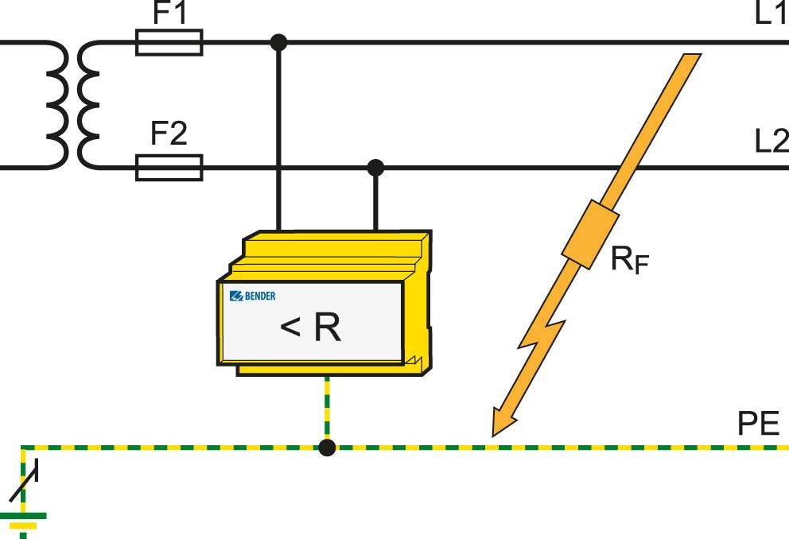
SAFETY CIRCUITS
Brake Plausibility Device
This safety device switches the car off incase the accelerator pedal gets stuck while driving.
The inputs to this device are Motor Power and Brake Pressure Sensor. This device signals the safe state of the vehicle based on these inputs.
If both Motor Power and Brake Pressure values together are beyond a set threshold value for more than 1 second, it signifies accelerator pedal getting stuck and this device kills the vehicle.
Insulation Monitoring Device
This safety device is used to monitor the insulation between Low Voltage and High Voltage system in the vehicle.
The insulation monitoring device is connected between the live supply conductors and earth.
In the event of an insulation fault, the measuring circuit between the system and earth is closed and current proportional to insulation fault flows through the device. If the fault is beyond the threshold then “unsafe” state is signalled.
Notes:
There are a few safety circuits in the passenger car.1) Brake System Plausibility Device: This devices checks if the motor power and brake pressure values are higher than threshold. If so then unsafe state is signaled to the ECU. Motor power and brake applied can only be high simultaneously in case of crashes. 2) Insulation Monitoring Device: This device is used to determine the short circuit among the various supply lines. It monitors the insulation between LV and HV systems. In the event of insulation fault the measuring circuit is closed and declares an unsafe state..2

Slide 26
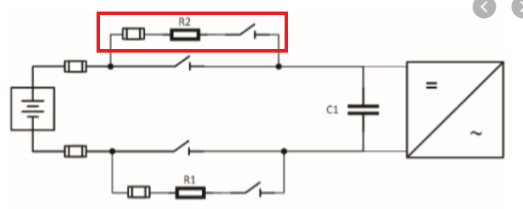
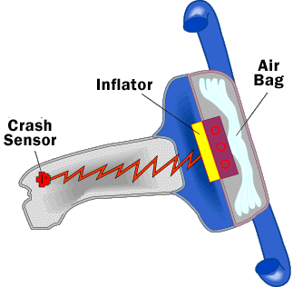
Pre-charge Circuitry
This is a protective feature for our motor controller by preventing large inrush current due to large capacitive load exposed at initial turn-on
Limits the inrush of current during the power up procedure till the DC bus capacitor is charged to around 90-95%.
Air Bags
This helps in protecting the passengers during a crash.
High amount of deceleration during a crash is detected by the crash sensor and this signal is used to then trigger inflation units to actuate air-bag deployment.
Notes:
3) Precharge Circuitry: When the vehicle is being switched on or during power up, there might be a high inrush of current to the motors. During these situations, it is safe to expose the high current to large capacitive load. This is taken care by a precharge circuit which consists of precharge relay and resistor.
4) Air bags: This helps in protecting the passengers during a crash. The amount of deceleration during a crash is detected by the crash sensor and this inflates the airbag with inert gases.

Slide 27
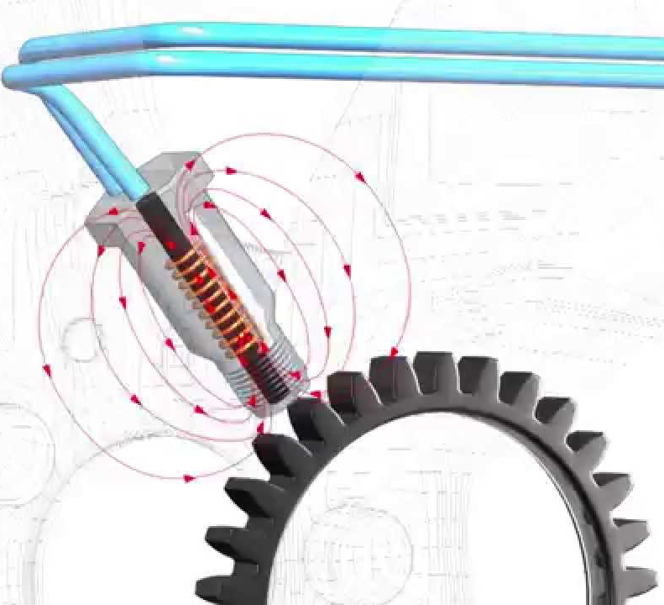
SENSORS
Current Sensor :Helps to derive the energy usage of the vehicle and the power supplied by the motor.
Accelerometer : Measures the Acceleration of the car and helps to determine a crash and also aids in activation of ABS.
Wheel Speed Sensor : Measures the wheel RPM which in turn is used to measure vehicle speed.
Pedal Sensors : Include Acceleration Pedal Position Sensor(APPS),Brake Position Sensor(BPS). These sensors help in determining the commanded torque to the motor controller.
Crash Sensors: Measures how quickly car slows down in frontal crash or accelerates in side impact . This triggers a chemical to burn and releases inert gases to fill the airbag.
Wheel speed sensor
Notes:
These are some of the critical sensors that are used in a passenger car. The current sensor measures the current supplied by the battery pack. This can be used to estimate the energy usage of the vehicle and the throttle applied. The accelerometer works based on piezoelectricity and measures the accelerations in the 3 orthogonal directions. The wheel speed sensor is based on induction of current in the gear tooth and the corresponding frequency of the AC signal generated. This also used to compute the vehicle speed from the vehicle dimensions.The pedal sensors help in determining the commanded torque to the motor controller and also indicate the same to the driver. The crash sensors help in activation of airbag during a crash.

Slide 28
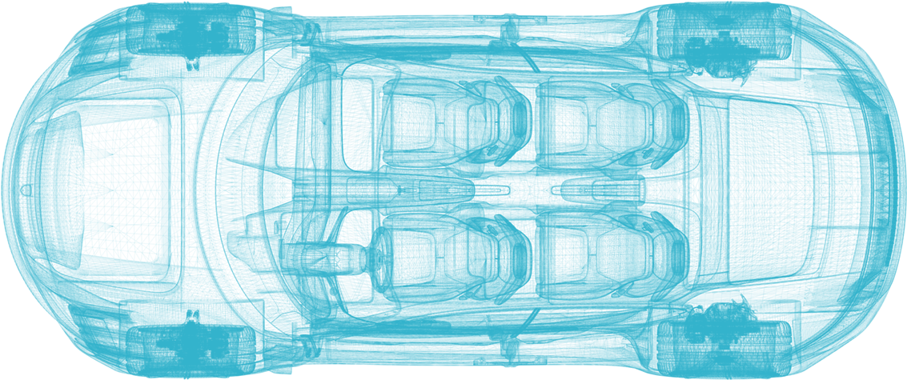
Electrical Architecture
SENSORS
BMS
LV BATTERY
(12V)
ECU
BATTERY PACK
MOTOR
SAFETY CIRCUITS
MOTOR CONTROLLER
Notes:
This is the proposed electrical architecture of the passenger car. The ECU collects and sends signals to various parts of the car. These signals are transmitted through CAN bus which is a differential bus and aids noise reduction. There are a few safety measures designed for the car which are also controlled by the ECU. We also have a BMS which is connected to the Accumulator and sends signals to the ECU. The ECU guides the motor controller to the commanded torque.This commanded torque is supplied by the motor to the drivetrain assembly.

